Slide 1
Solar Orbiter mission
César García – project manager

Slide 2
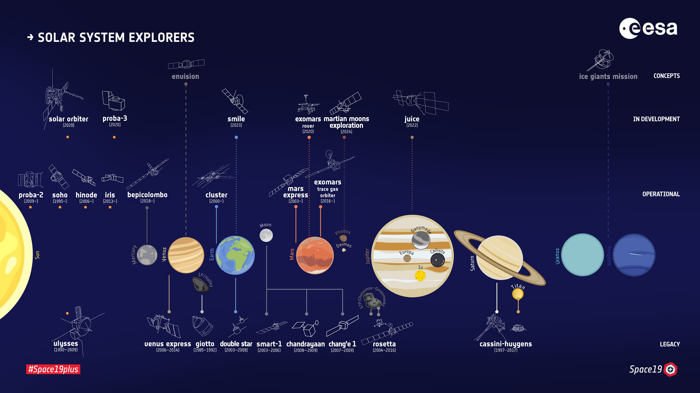
The ESA Fleet in the Solar System
Notes:
The ESA fleet in the solar system
Lowest line: missions that ended operations
Middle line: missions now in operation
Top line: missions in development or future
Since the beginning of the 1990s, six unprecedented spacecraft built in Europe for the Ulysses, SOHO and Cluster missions have been investigating the Sun and its impact on our planet. With Solar Orbiter, we will take a close approach to find out ever more about our nearest star.
Solar Orbiter is a mission dedicated to solar and heliospheric physics. It was selected as the first medium-class mission of ESA's Cosmic Vision 2015-2025 Programme. The programme outlines key scientific questions which need to be answered about the development of planets and the emergence of life, how the Solar System works, the origins of the Universe, and the fundamental physics at work in the Universe.
Solar Orbiter addresses central questions concerning our Sun: How does our Sun create and control the heliosphere – the giant bubble of magnetised plasma around it; what drives the solar wind, and why does solar activity change with time?

Slide 3
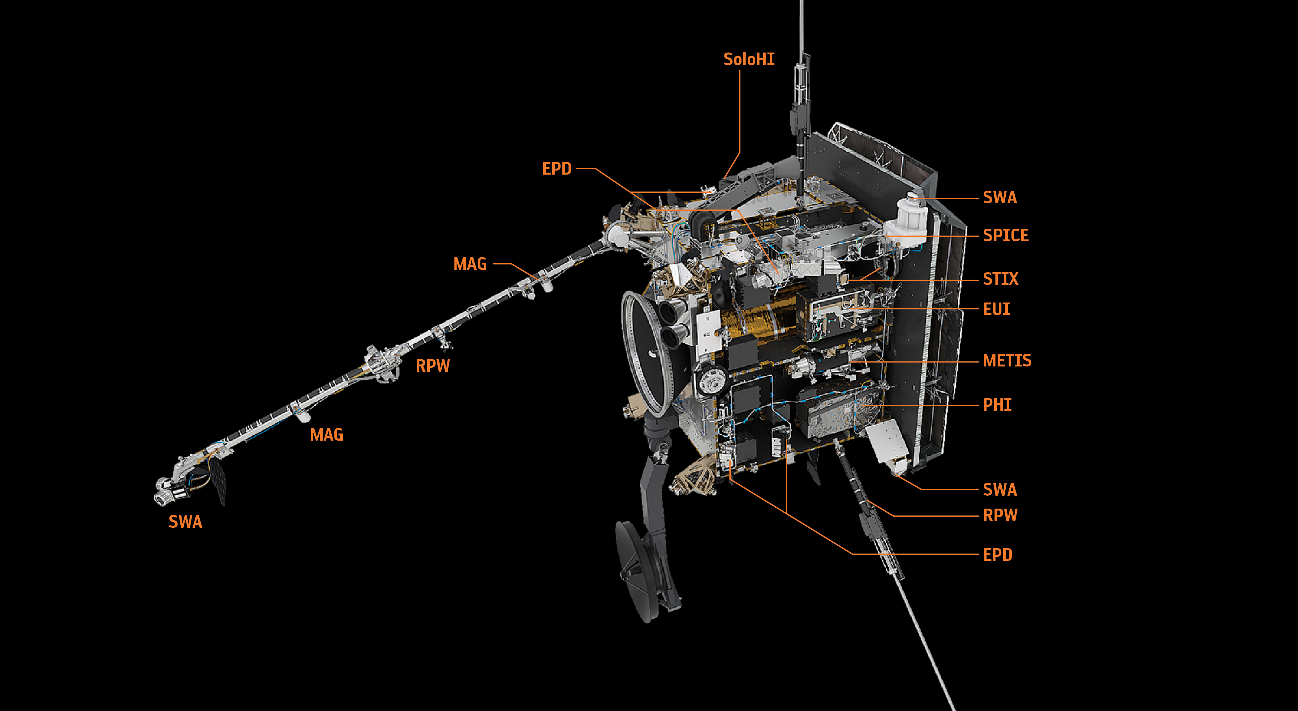
Science top level questions & payload complement
How does the Sun create and control the Heliosphere?
Why does solar activity change with time?
Instruments were developed and provided by Principal Investigators
 | Instrument Name | Scientific Purpose
In-Situ Instruments | Energetic Particle Detector (EPD) | EPD will measure the energetic particles that flow past the spacecraft. It will look at their composition and variation in time.
 | Magnetometer (MAG) | MAG will measure the magnetic field around the spacecraft. It will help determine how the Sun’s magnetic field links to the rest of the solar system and changes with time.
 | Radio & Plasma Waves experiment (RPW) | RPW will measure the variation in magnetic and electric fields using a number of sensors and three antennas.
 | Solar Wind Analyser (SWA) | SWA consists of a suite of sensors that will measure the solar wind’s bulk properties, such as density, velocity and temperature. It will also measure the composition of the solar wind.
Remote Sensing Instruments | Extreme Ultraviolet Imager (EUI) | EUI will take images of the solar chromosphere, transition region and corona.
 | Coronagraph (Metis) | Metis will take simultaneous images of the corona in visible and ultraviolet wavelengths.
 | Polarimetric & Helioseismic Imager (PHI) | PHI will provide high-resolution measurements of the magnetic field across the photosphere, and maps of its brightness at visible wavelengths.
 | Heliospheric Imager (SoloHI) | SoloHI will take images of CME (coronal mass ejections) and of the solar wind by capturing the light scattered by electrons and particles in the wind plasma.
 | Spectral Imaging of the Coronal Environment (SPICE) | SPICE will reveal the properties of the solar transition region and corona by measuring the extreme ultraviolet wavelengths given off by the plasma.
 | Spectrometer/Telescope for Imaging X-rays (STIX) | STIX will detect X-ray emission coming from the Sun. This could be from hot plasma, often related to explosive magnetic activity such as solar flares.
Notes:
How does our Sun create and control the heliosphere – the giant bubble of magnetised plasma around it; what drives the solar wind,
and why does solar activity change with time?

Slide 4
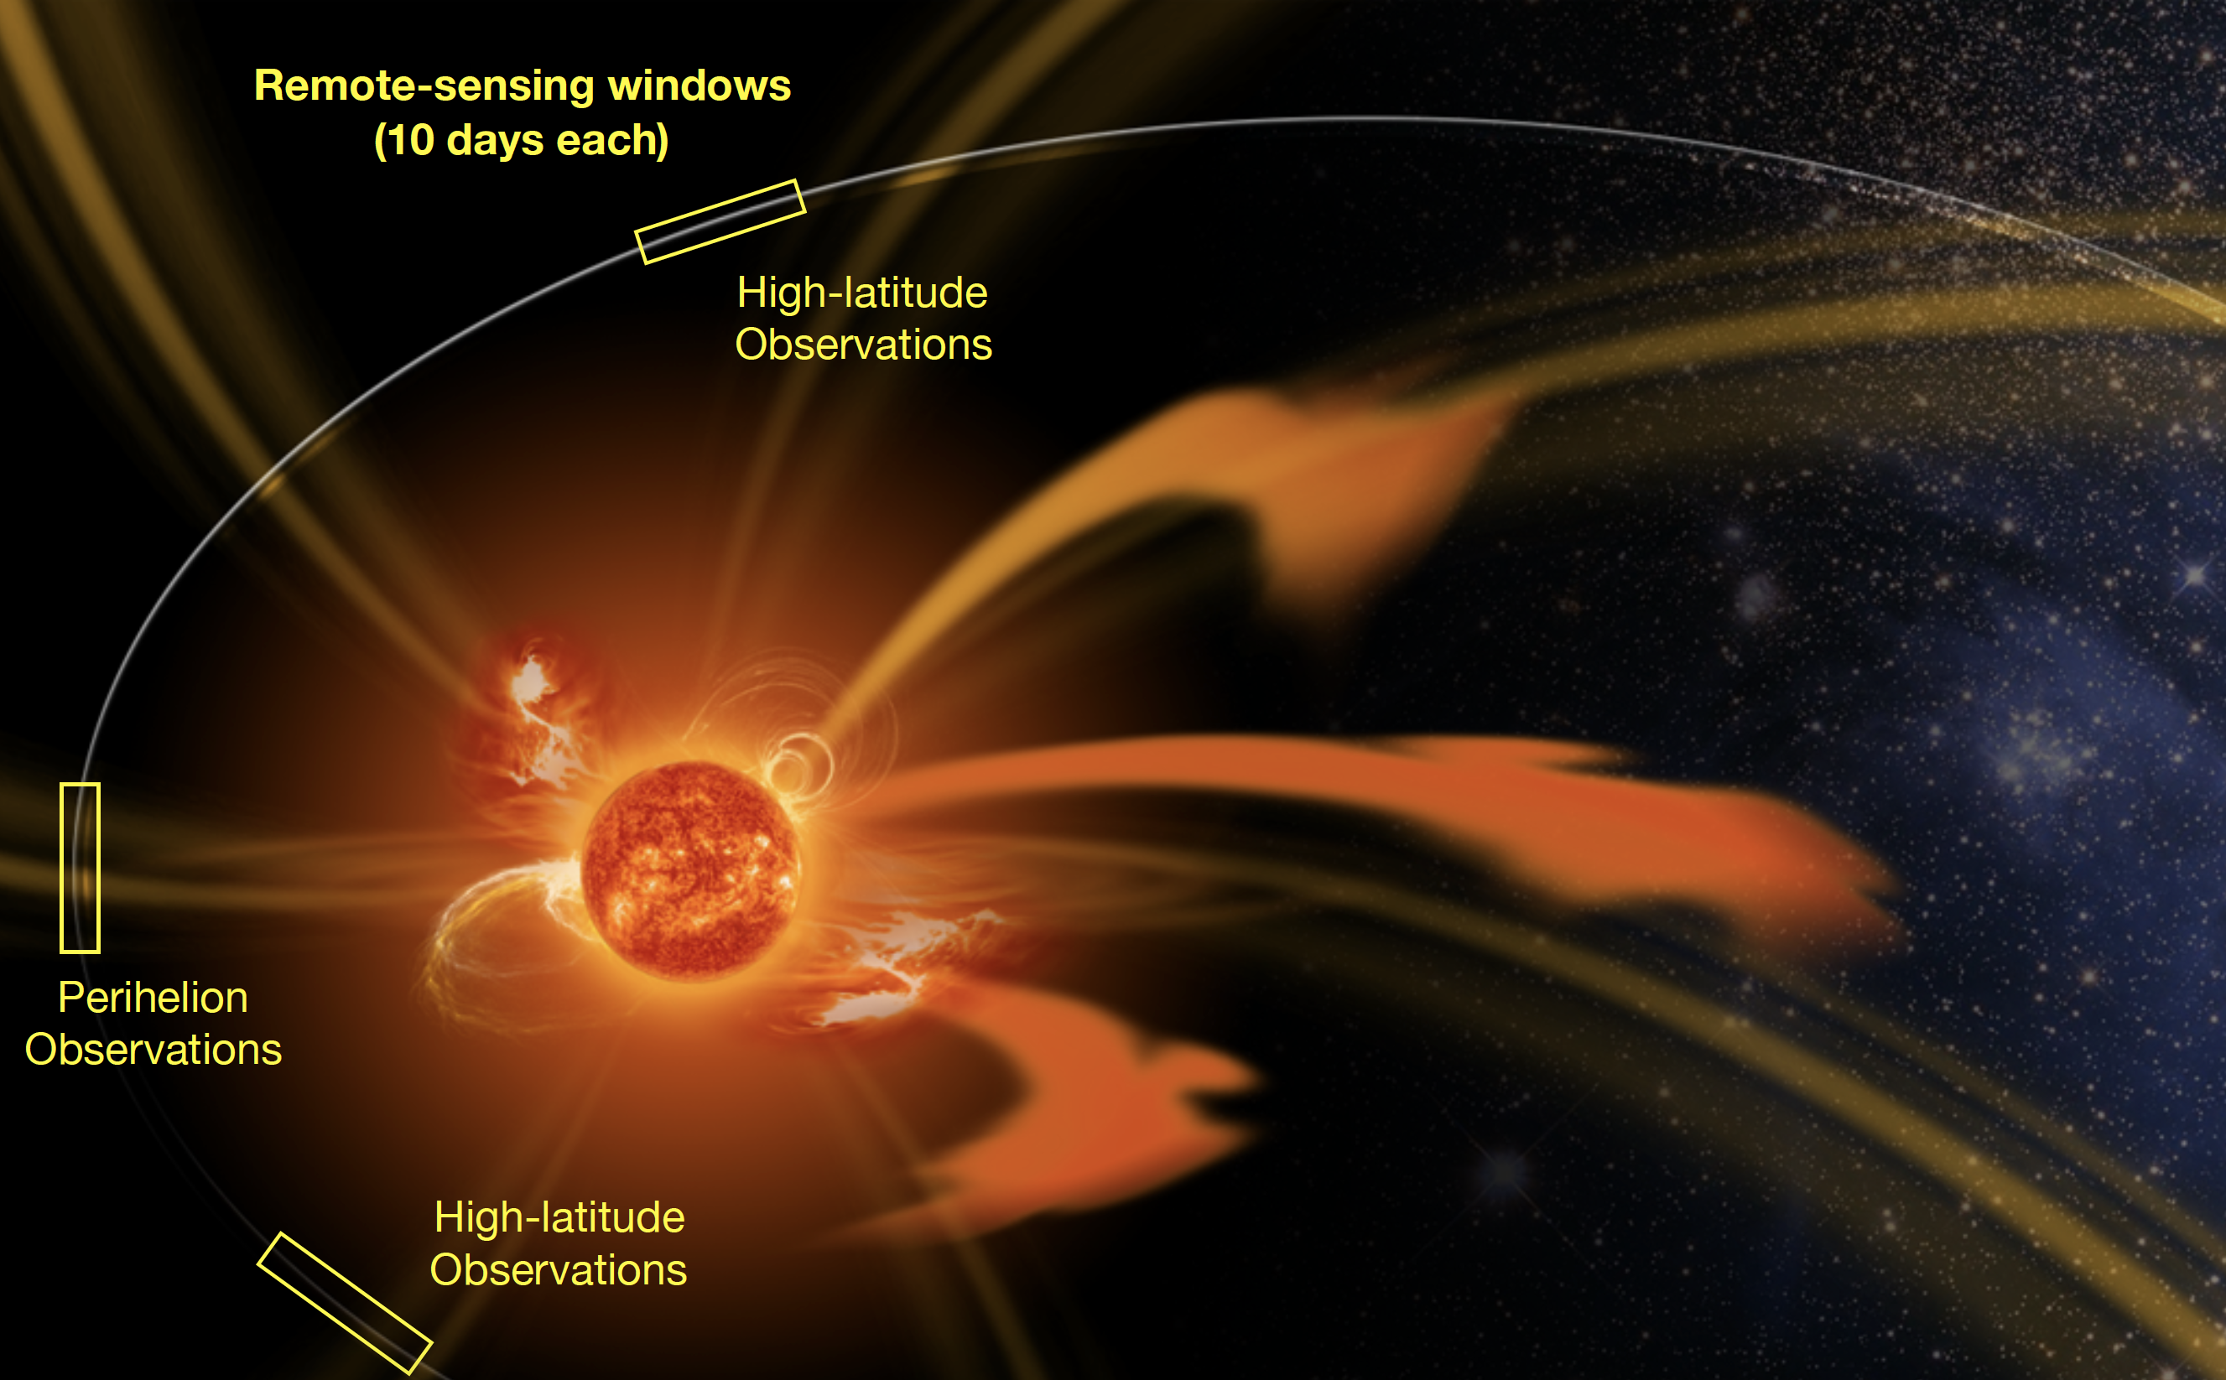
Mission summary
Dry mass: ~1,500kg
Wet mass: ~1,750kg
Available power (EoL, aphelion): 1,300W
Earth link: ~2-27.4 Gbit/day
Main ground station: Marlagüe, 35m
Launch: 6 Feb 2020 (UTC)
Launcher: Atlas V-411
Launch Complex 41, NASA-KSC
Direct escape trajectory to Venus
ESA mission, with strong NASA participation

Slide 5
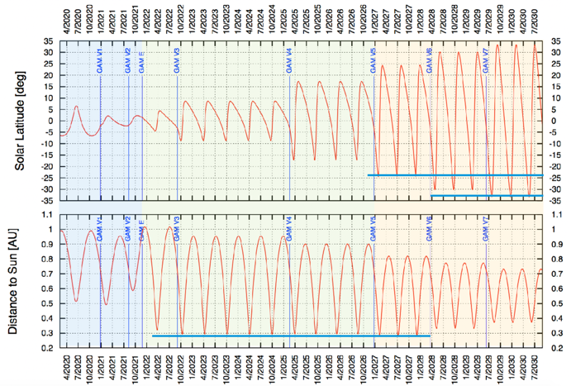
Mission summary
Cruise: 1.8 yr
Nominal mission: 4 yr
Extended mission: 3.5 yr
Orbit: 0.28-0.91 AU
Period: 150-180 d
Out of ecliptic:
>24 deg (nominal mission)
>33 deg (extended mission)
Reduced relative rotation: evolving structures on solar surface & heliosphere for almost a complete solar rotation
Notes:
0.28 AU is 42 million km

Slide 6
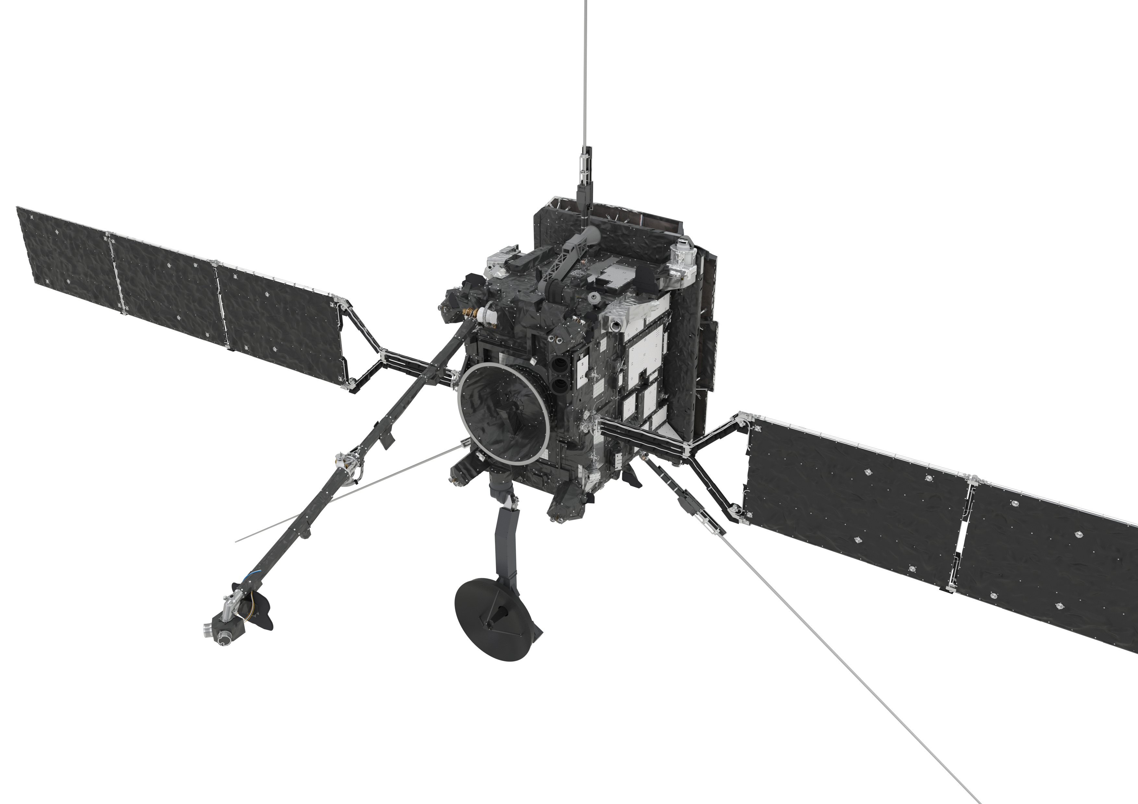
Drivers and challenges
Thermal control
Magnetic field and electrical charging
Stray light
Autonomous control
Pointing
Cleanliness
Render of Solar Orbiter
Notes:
Launch mass ~1,750kg
Science payload mass 209kg
Body 2.5 x 3.1 x 2.7 m
Wing span (total) 18 m
Each solar panel 2.1 x 1.2 m
Available power (EoL, aphelion): 1,300W
Payload power 180W
I-boom 4.4 m
3 RPW antennas 6.5m
A redundant set of nine 10N thrusters
X-band, 2 LGA, 1MGA, 1HGA
AOCS: After separation from the launcher and in case of safe mode, Fine Sun Sensors and gyros are used to measure the attitude and support rate reduction spacecraft orientation. A gyro-stellar (STR & Gyro) attitude control system takes control once attitude is converged. The Fine Sun Sensors are then used as an independent Attitude Anomaly Detector (AAD), along with a 2nd IMU as a Rate Anomaly Detector (RAD), in support of the top-level FDIR which enforces the Sun-pointing attitude of the SC to within a transient off-pointing of 6.5° from the Sun-line during all credible attitude failures. A redundant set of nine 10N dual-seat valve thrusters is used for Safe Mode attitude control, wheel off-loading and dV manoeuvres. The thrusters are complemented by a set of four reaction wheels used during nominal modes to achieve the fine-pointing required by the RS-instruments.

Slide 7
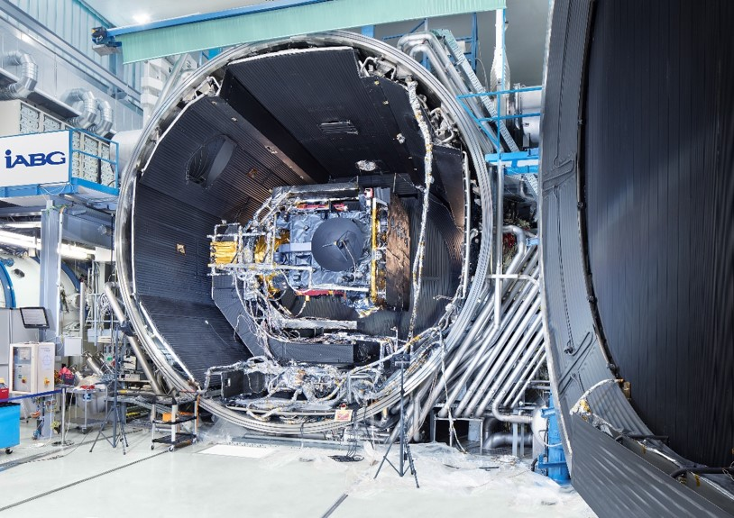
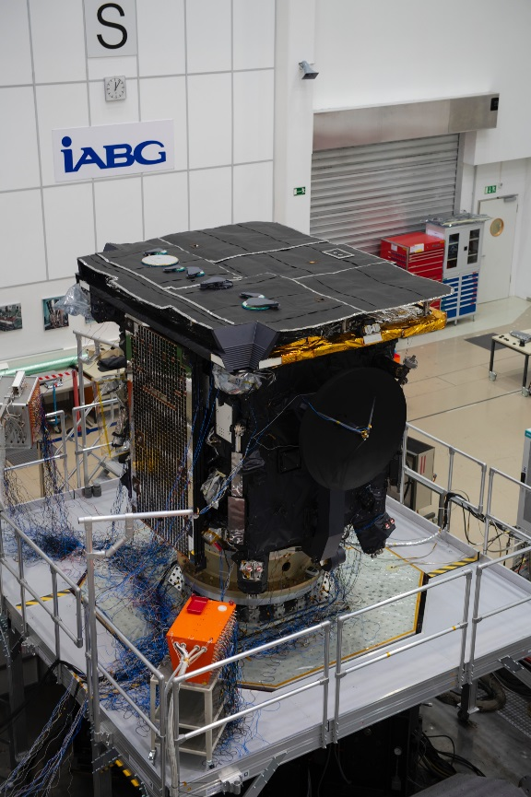
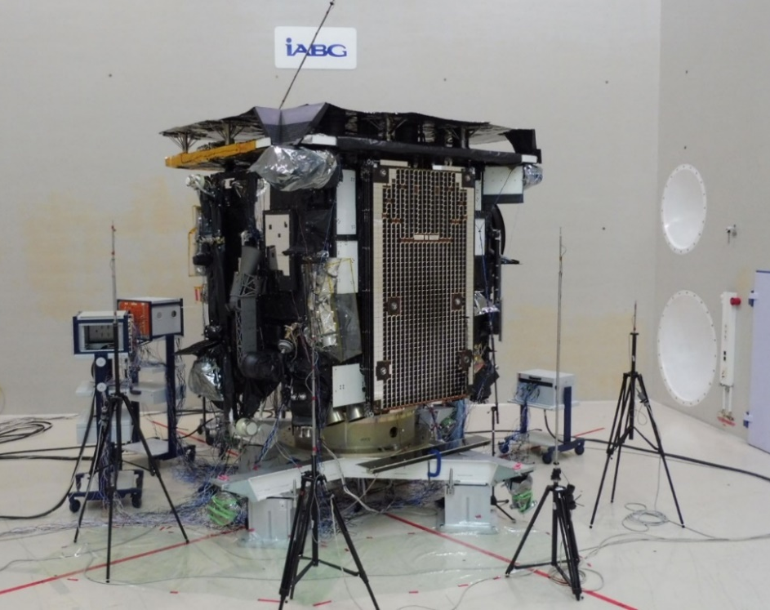
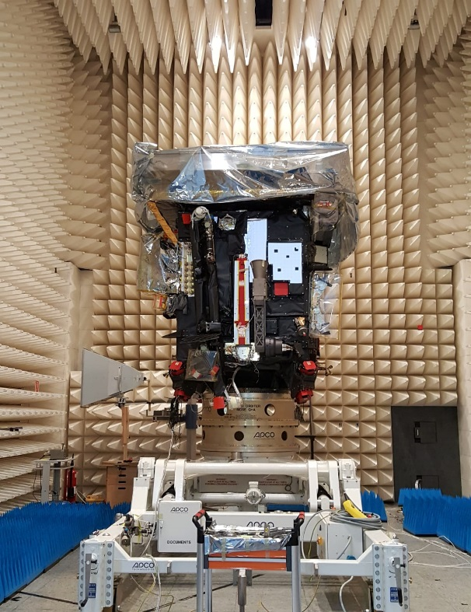
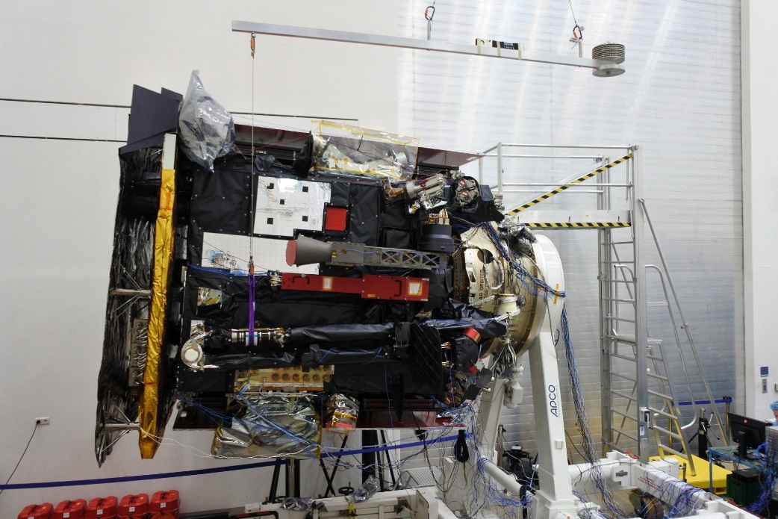
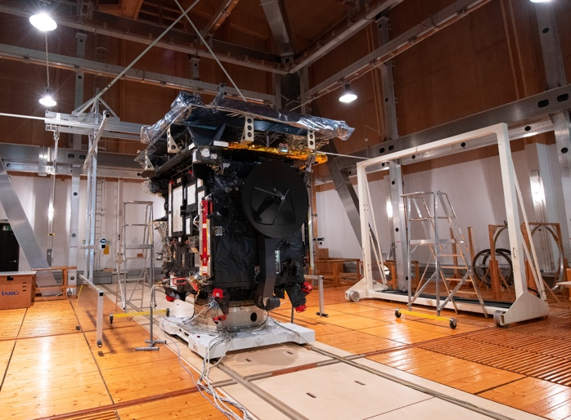
Testing for the harsh space environment
1
2
3
4
5
6

Slide 8
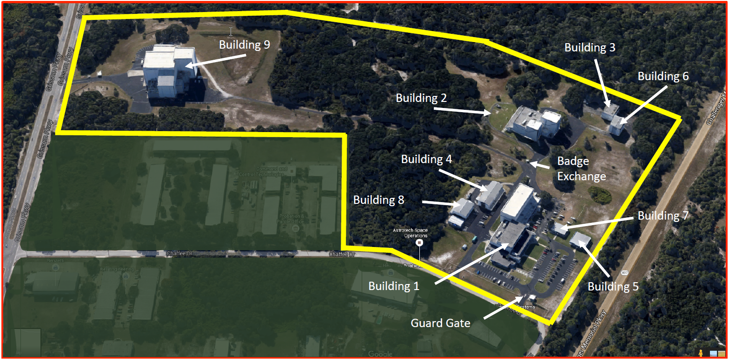
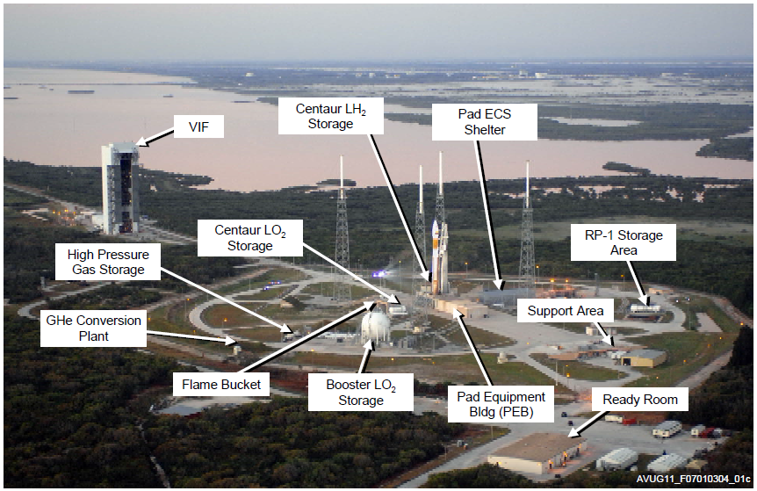
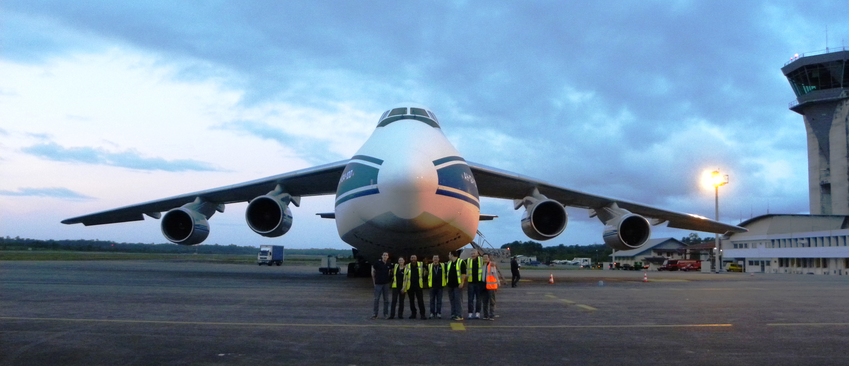
Launch campaign
S/C processing facility – ready
Launcher vehicle production status – as planned
S/C arrival on 31 Oct
Start of integrated operations on 16 Jan 2020
Launch date 6 Feb 2020 (UTC)
Astrotech and KSC’s launch complex 41
Antonov-124, Cayenne Airport

Slide 9
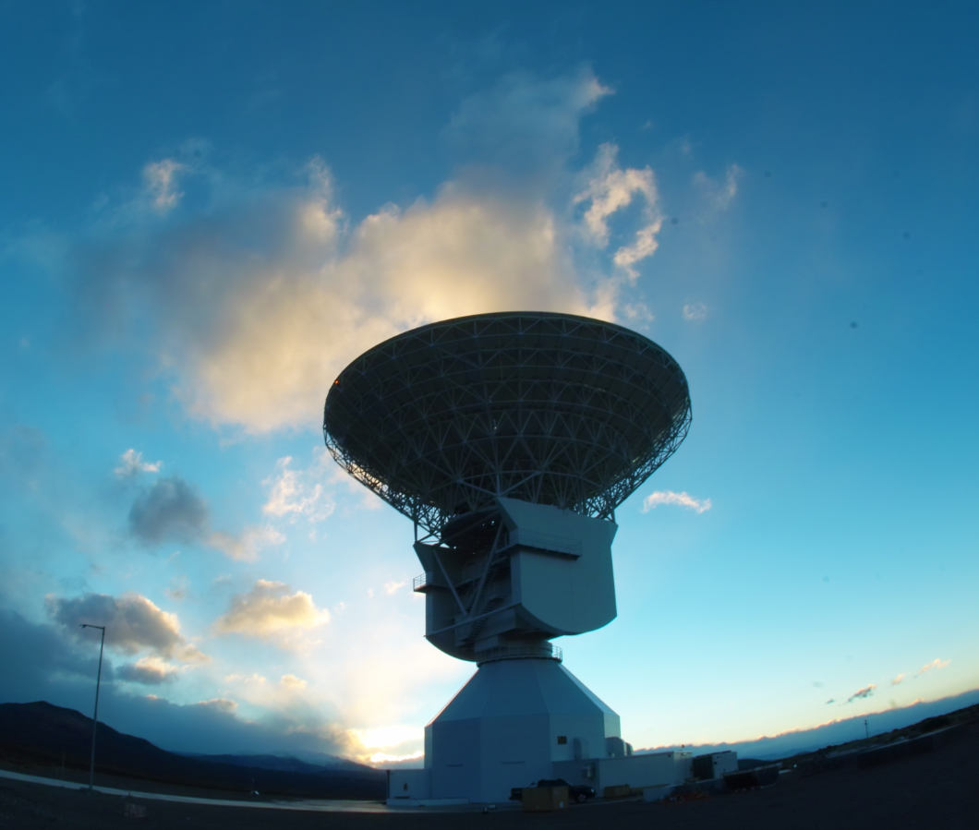
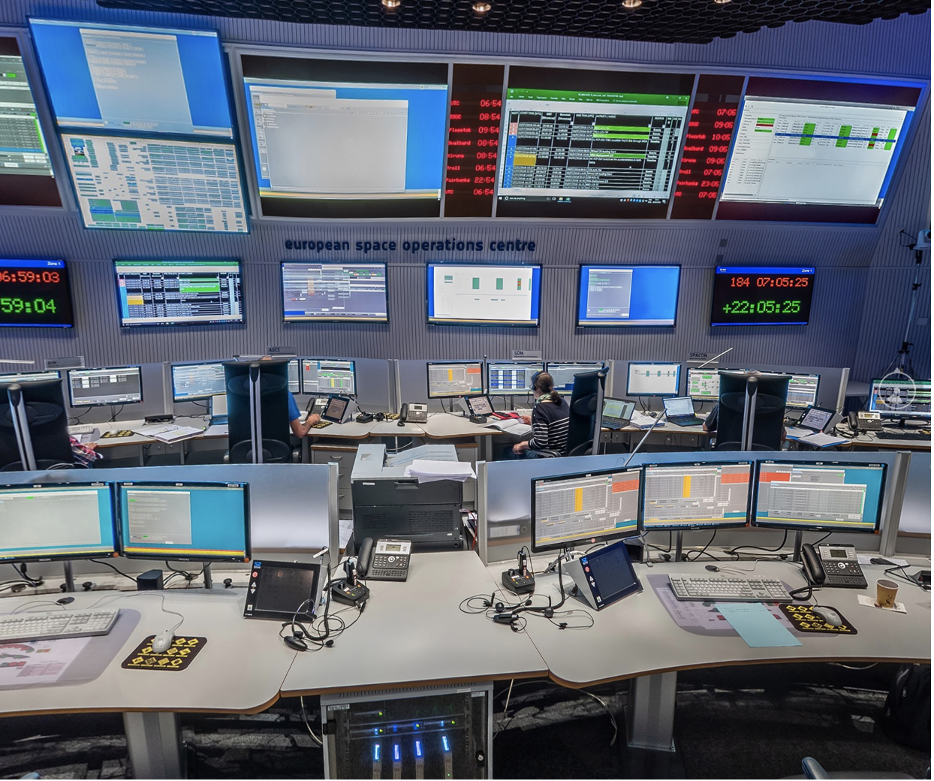
Flight operations
Operated from ESOC and ESAC
ESTRACK ground stations
Collaborative long-term planning
Frequent solar conjunctions
“Tidal” data backlog, <5 months latency
Marlagüe 35 m antenna, Argentina
ESOC’s main control room, Darmstadt
Notes:
The Malargüe station, Deep Space Antenna 3, is ESA's newest tracking station and is located 30 km south of the city of Malargüe, about 1200 km west of Buenos Aires, Argentina. DSA 3 hosts a 35 m-diameter antenna with transmission and reception in X-band and reception in Ka-band.
DSA 3 was inaugurated in December 2012 and entered full service in early 2013. Today, it provides daily support to missions such as Gaia, Mars Express, Rosetta and ExoMars.
Location
The coordinates of the antenna are 35° 46' 33.63" S (35.776°S), 69° 23' 53.51" W (69.398°W), and the station is sited at 1550 m above sea level.
The station is a 45-km drive from Malargüe city, in Mendoza province. Malargüe has a population of some 23 000 and is also home to the southern site of the Pierre Auger Observatory, an international physics experiment searching for ultra-high-energy cosmic rays.
Facilities & technology
The Malargüe station incorporates state-of-the-art technology. Its technical facilities comprise Ka-band reception (31.8–32.3 GHz) and X-band transmission and reception. It is prepared to host Ka-band transmission (34.3–34.7 GHz) and K-band reception (25.5–27 GHz).
Its main functions are to receive telemetry, send telecommands and perform radiometric measurements (ranging, Doppler, Delta-DOR) on scientific and deep-space craft.
The dish is 35 m in diameter and the entire structure is 40 m high; its moving antenna weighs 610 tonnes. Engineers can move the antenna with a speed of up to 1 degree per second in all axes. The servo control system ensures the highest possible pointing accuracy under the site’s harsh environmental, wind and temperature conditions.
The station has a frequency and timing system based on atomic clocks using masers and crycooled sapphires. Communications are via the ESA Operations Network (OPSNET). The site is equipped with a no-break power plant.
The antenna’s radio-frequency (RF) system comprises a Cassegrain Beam Wave Guide operating with frequency-sensitive (dichroic) mirrors and X- and Ka-band feeds, helium-cooled X- and Ka-band low-noise amplifiers, a 400 W solid-state power amplifier, and 2 and 20 kW X-band transmitters.
Operations
The station provides routine spacecraft tracking support to ESA's deep-space missions such as Venus Express and Mars Express, and scientific missions such as Herschel and Planck, as well as to other agencies’ missions under resource-sharing agreements. Malargüe will also support future ESA scientific missions, including LISA Pathfinder, Gaia and BepiColombo.
For routine operations, the station is remotely controlled from ESOC, Darmstadt, Germany. Local maintenance and operation is provided by a team of five engineers.
Delta DOR, GPS-TDAF, radio science
The station is also equipped with delta-DOR receivers (Delta Differential One-Way Ranging), a new technology enabling highly precise spacecraft location and tracking.
A GPS-TDAF (GPS Tracking and Data Analysis Facility) dual-frequency receiver system with geodetic accuracy is installed, which delivers continuous measurements to the ESOC Navigation Facility.
The station also hosts facilities enabling scientists to analyse received signals to perform radio science experiments.
Construction
Construction of the station started in late 2009 and the huge dish reflector was hoisted into place on 7 December 2011. The station received the first test signals from Mars Express, at a distance of 193 million km, on 14 June 2012. It is set for formal inauguration on 18 December 2012, and will enter routine service early in 2013.
The site was chosen for ESA's third deep-space antenna for several reasons.
In order to obtain global coverage, DSA 3 had to be located about 120° in longitude from the existing DSA stations in Australia and Spain, which meant a location somewhere in the Americas. ESA’s DSA stations also use delta-DOR, which works best when the stations involved are as far apart as possible.
The choice between North and South America was also driven by the fact that NASA already has plenty of station capacity in North America, so it made sense to build in South America.
The final location was chosen after securing a long-term lease for the site and the requisite radio frequencies from Argentina.
The agreement to build and exploit the station was signed with Argentina on 16 November 2009, for a planned duration of 50 years. The agreement contains benefits, facilities and services to be provided by Argentina. In exchange, ESA will make available to Argentina 10% of the antenna time for their national scientific projects. Argentina's Comisión Nacional de Actividades Espaciales (CONAE) is responsible for coordinating the use of the 10% of antenna time as provided in the agreement.
1972 Andes flight disaster
The foreboding beauty of the landscape near Malargüe, high in clear mountain air, is famous for the 1972 Andes flight disaster, dramatised in the 1993 film Alive: The Miracle of the Andes. The actual crash site in the mountains is 138 km, as the crow flies, from ESA’s station.

Slide 10
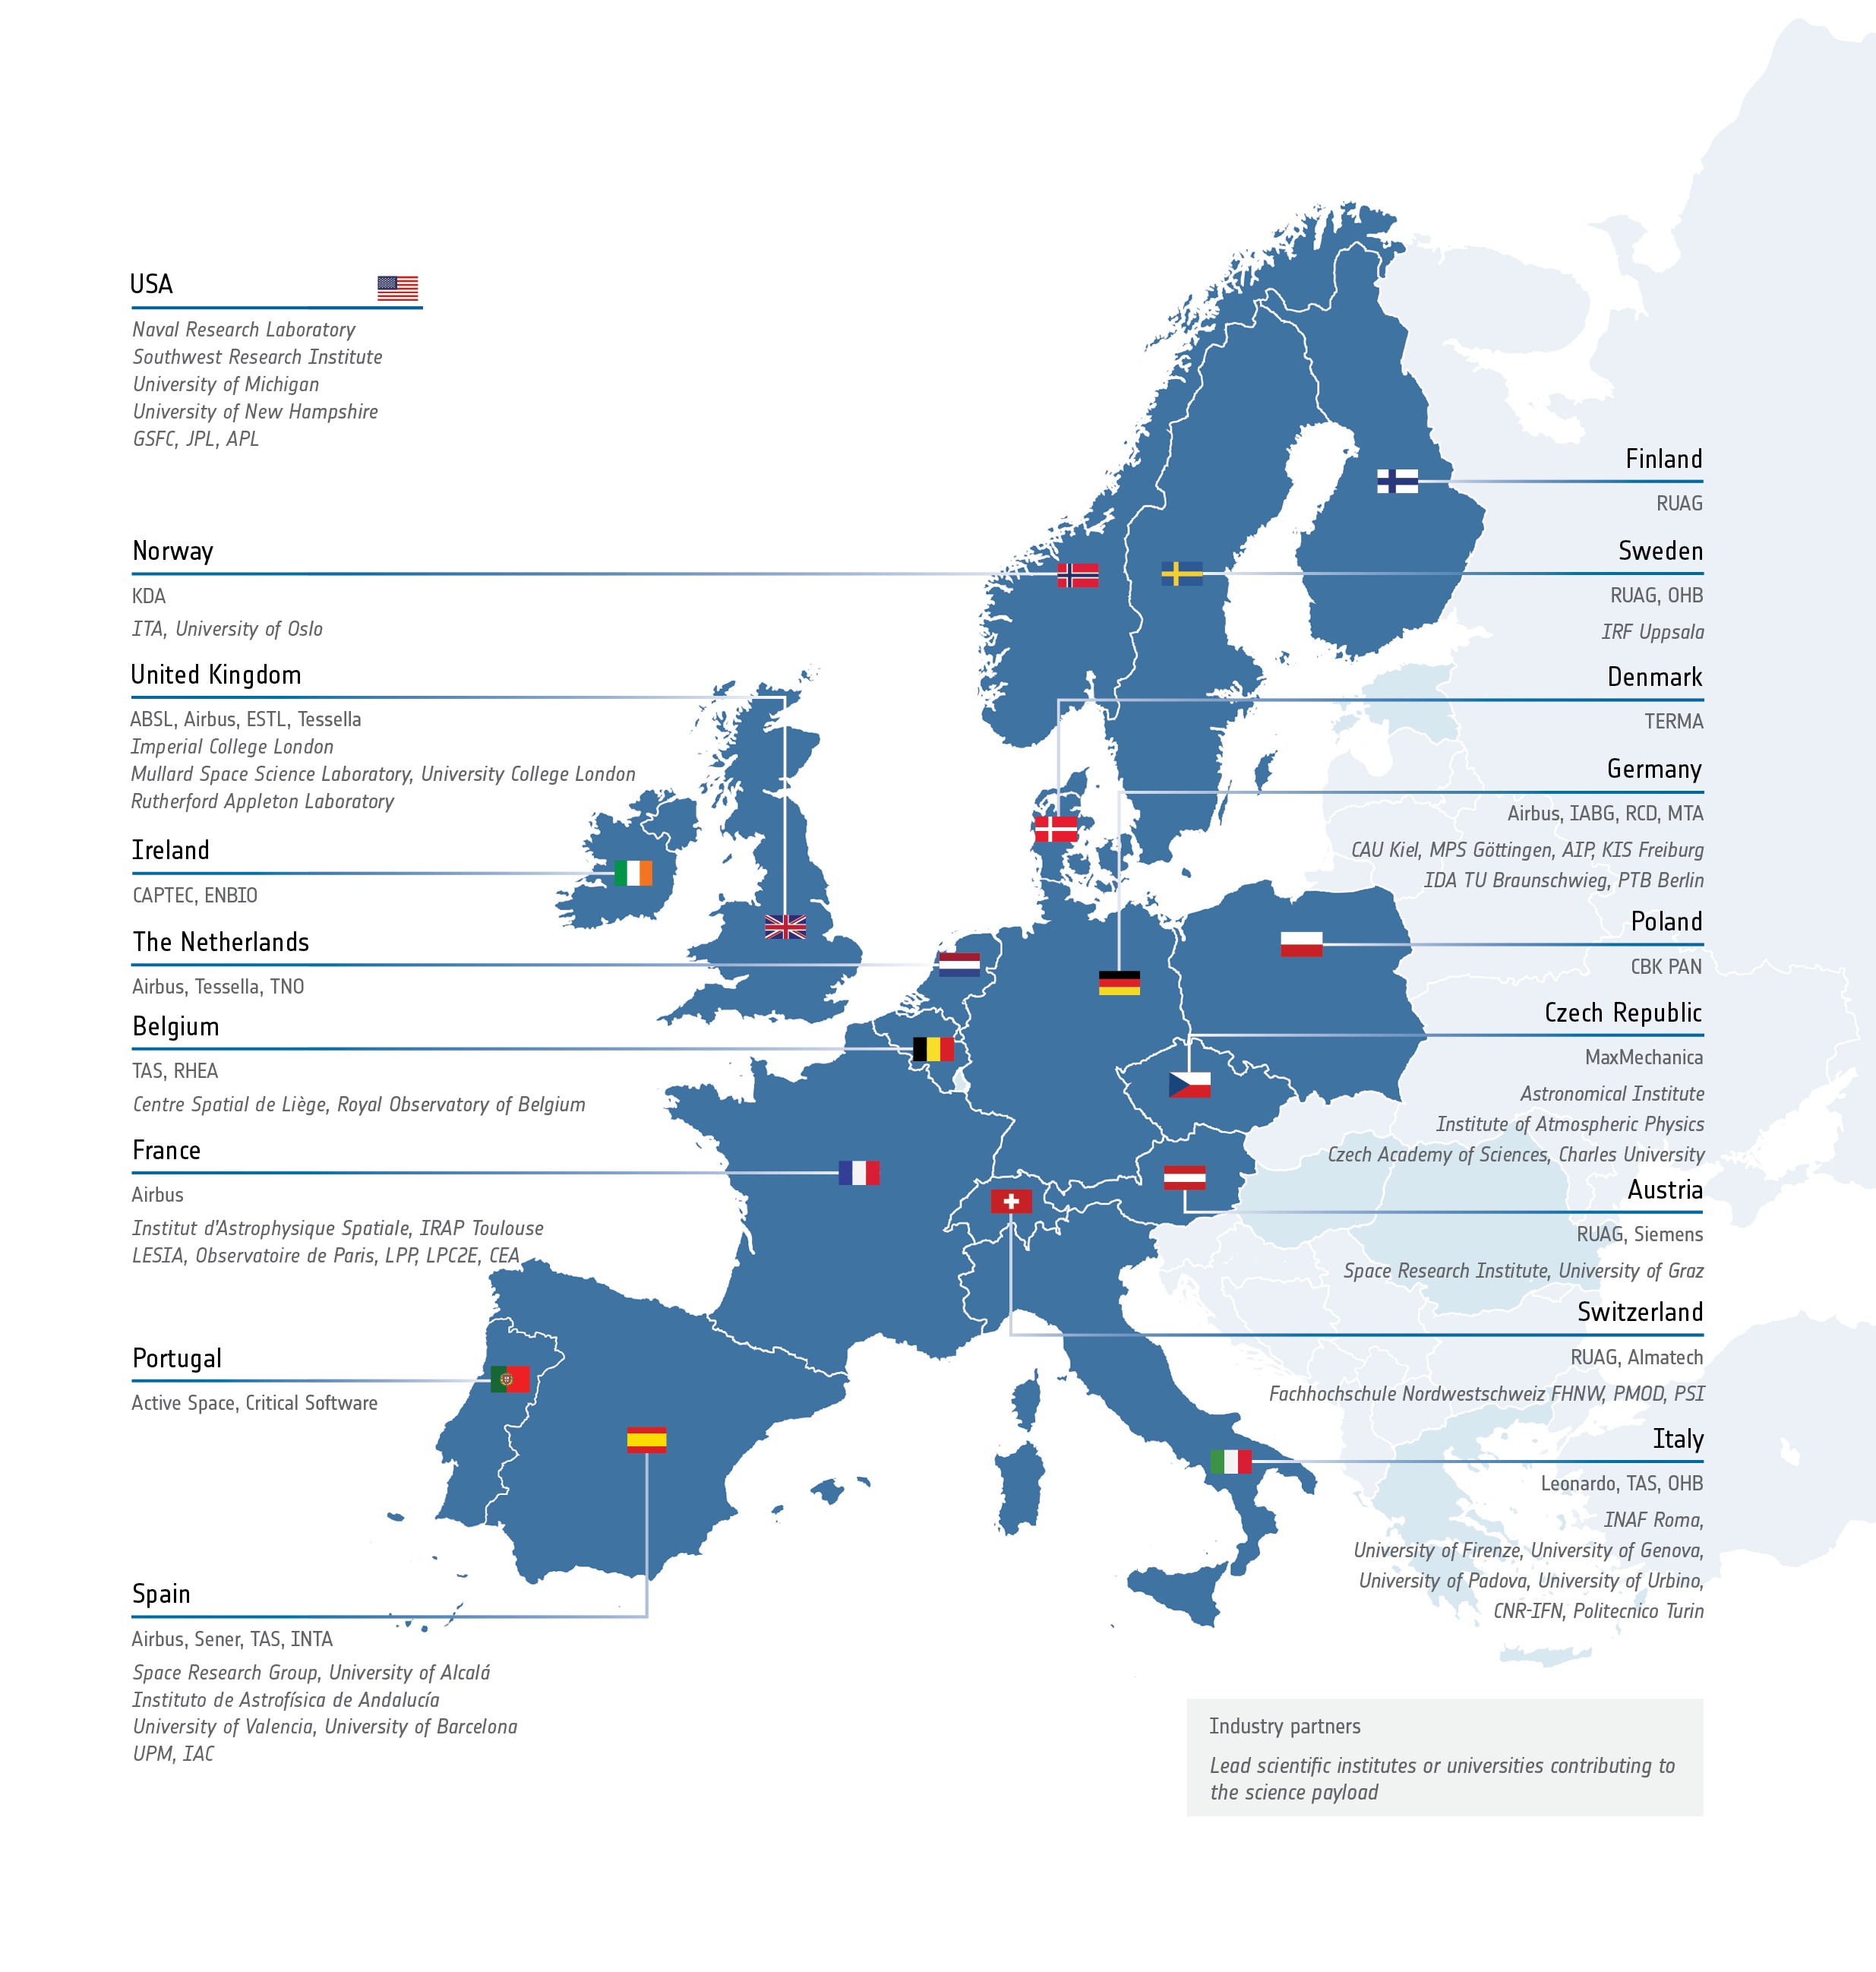
An international enterprise
Main European contributors from 17 ESA Member and Cooperating States
Collaboration with NASA

