Slide 1
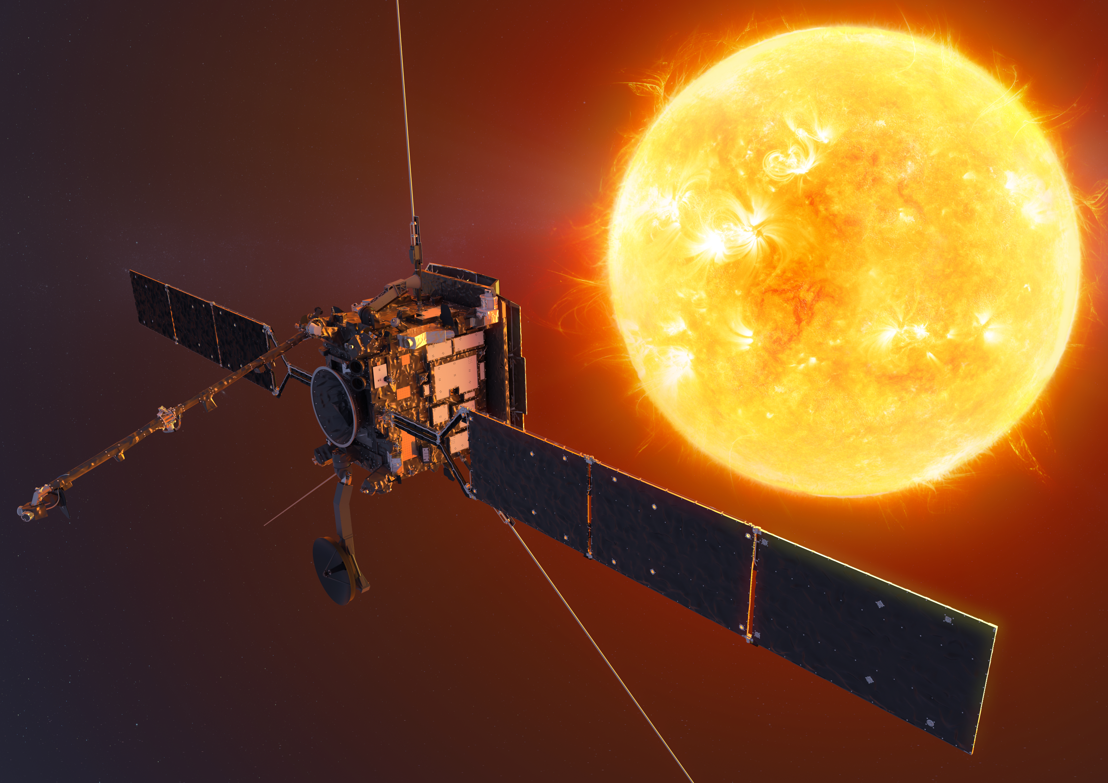


Solar Orbiter
Remote Sensing Science
Frédéric Auchère
On behalf of the Remote Sensing instruments consortia

Slide 2
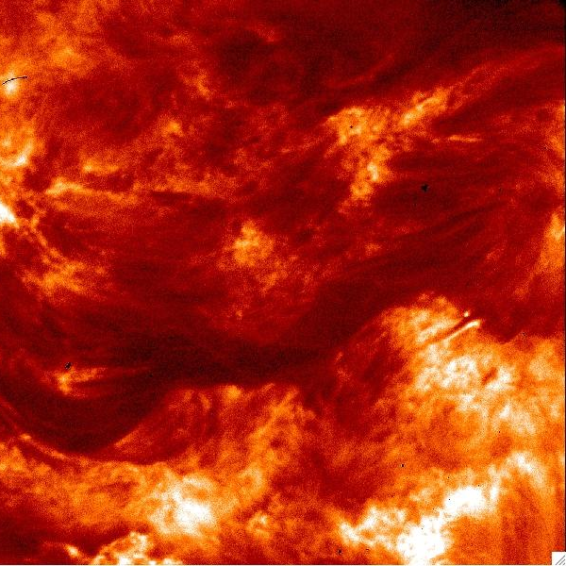
Orbiter @ 42 000 000 km
?
?
Going to new places
Orbiter @ 35° latitude

Slide 3
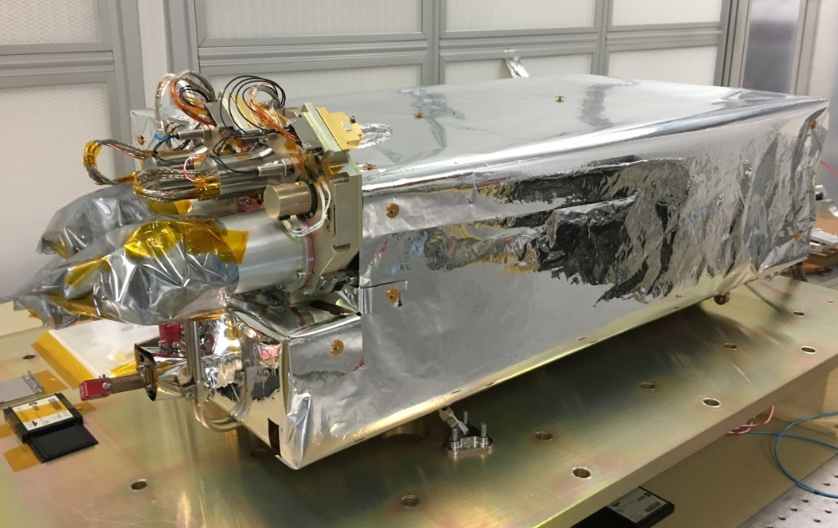
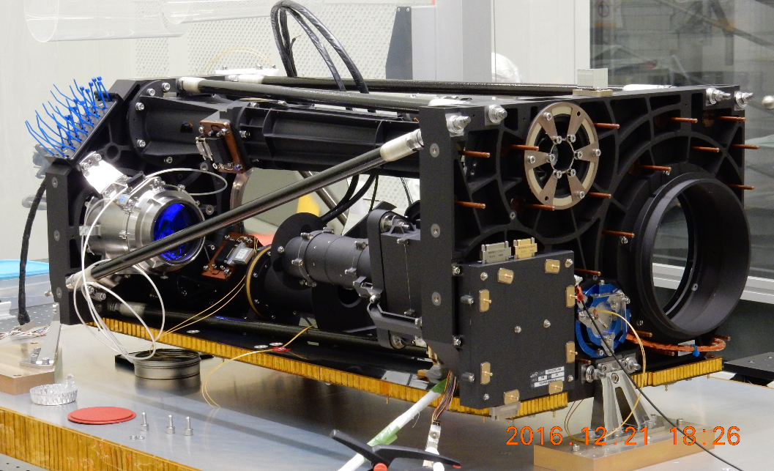
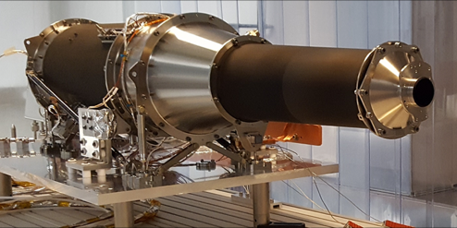
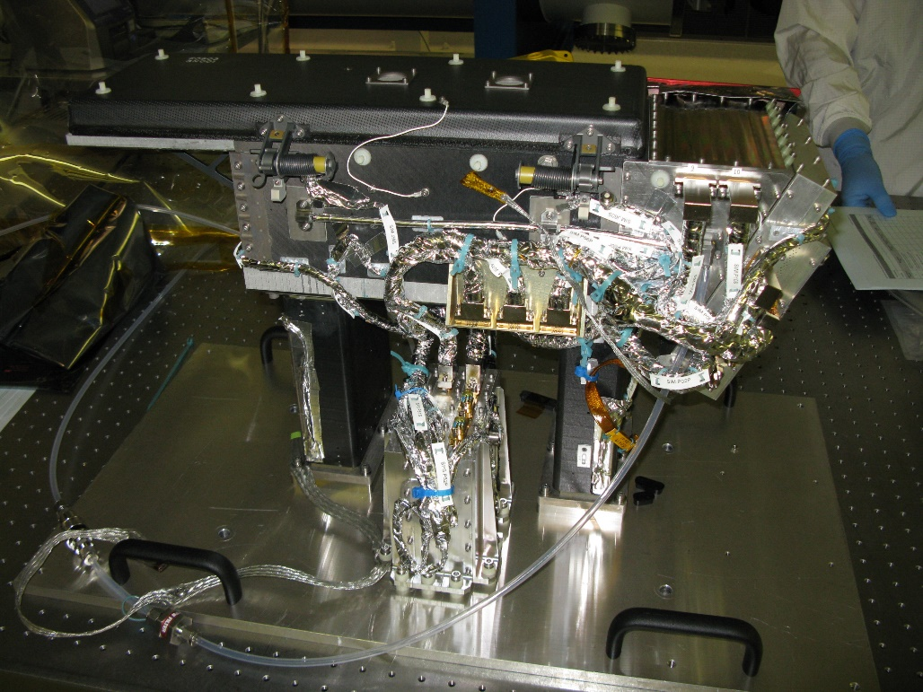
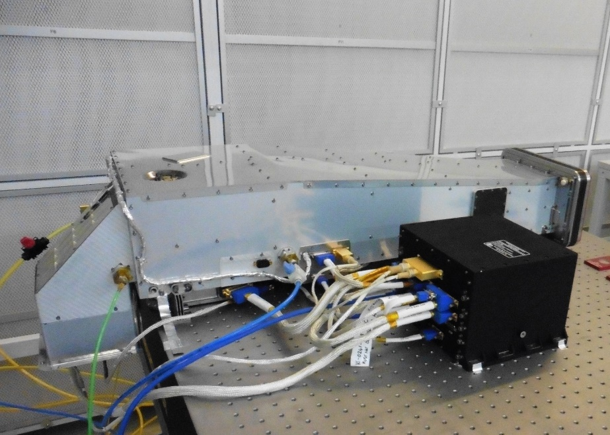
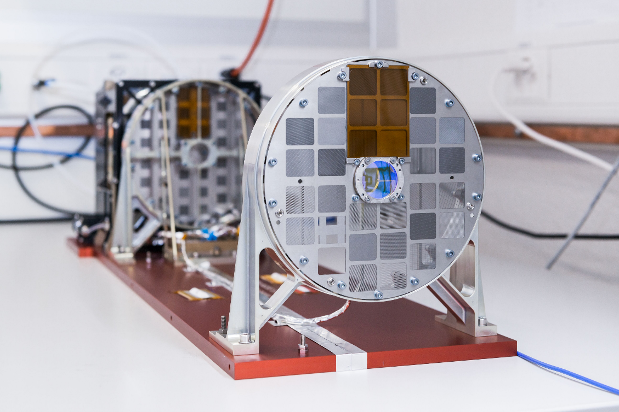










Meet the Solar Orbiter telescopes
EUI
PHI
Metis
SoloHI
SPICE
STIX

Slide 4
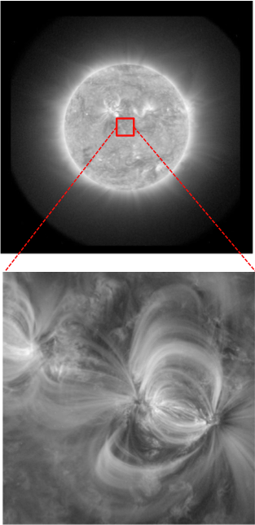
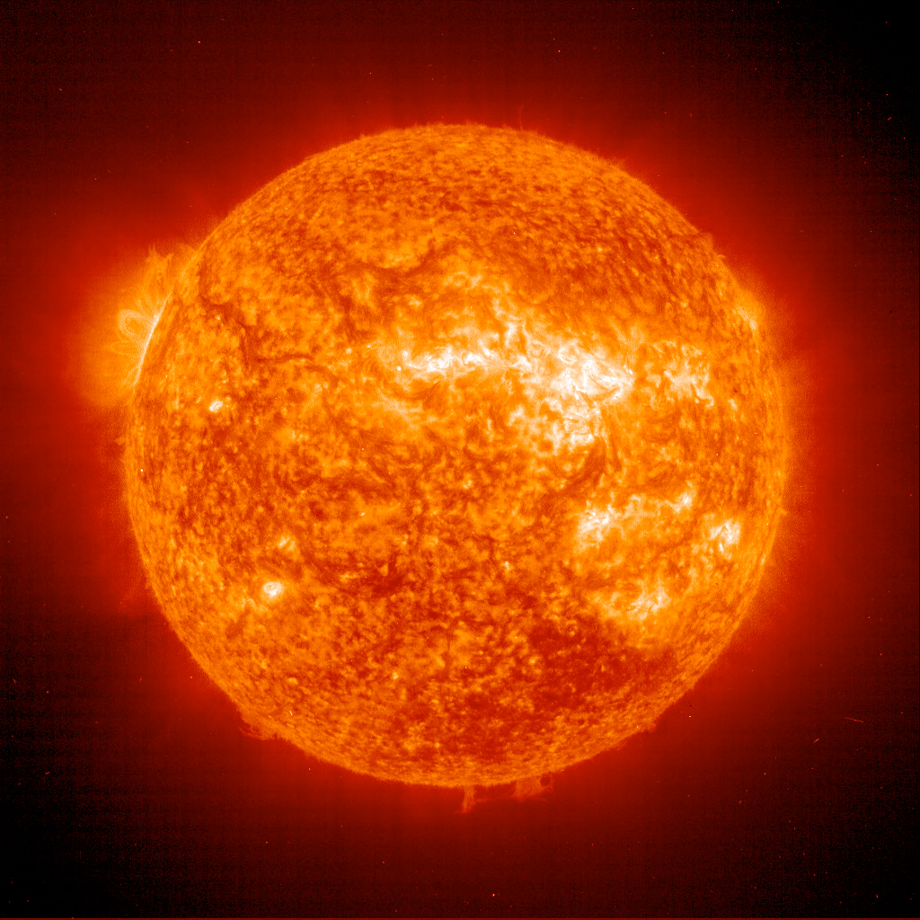
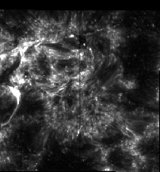
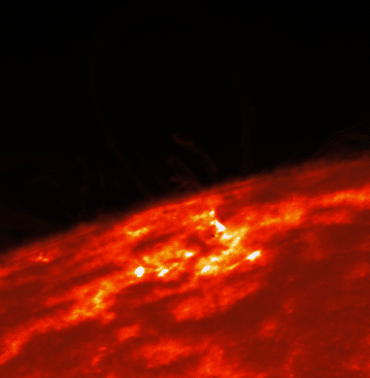
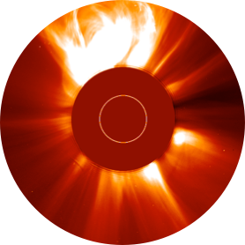
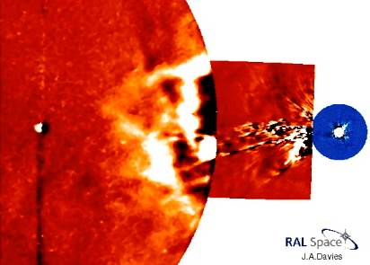
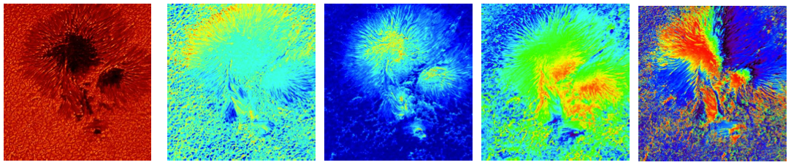
Comprehensive measurements
EUI/FSI 17.4nm
EUI/FSI 30.4nm
STIX (+ spectra)
    SPICE (+ spectra)
Images & spectra …
… from the visible to the X-rays …
… from the surface out to the heliosphere
Velocity
Density
Temperature
Magnetic field
Chemical composition
EUI/HRI 17.4nm
EUI/HRI Ly-alpha
METIS VL
+ similar for
Ly-α
SoloHI
PHI/HRT
Continuum
+ similar images for PHI/FDT
B_LOS
B inclination
B azimuth
LOS velocity

Slide 5
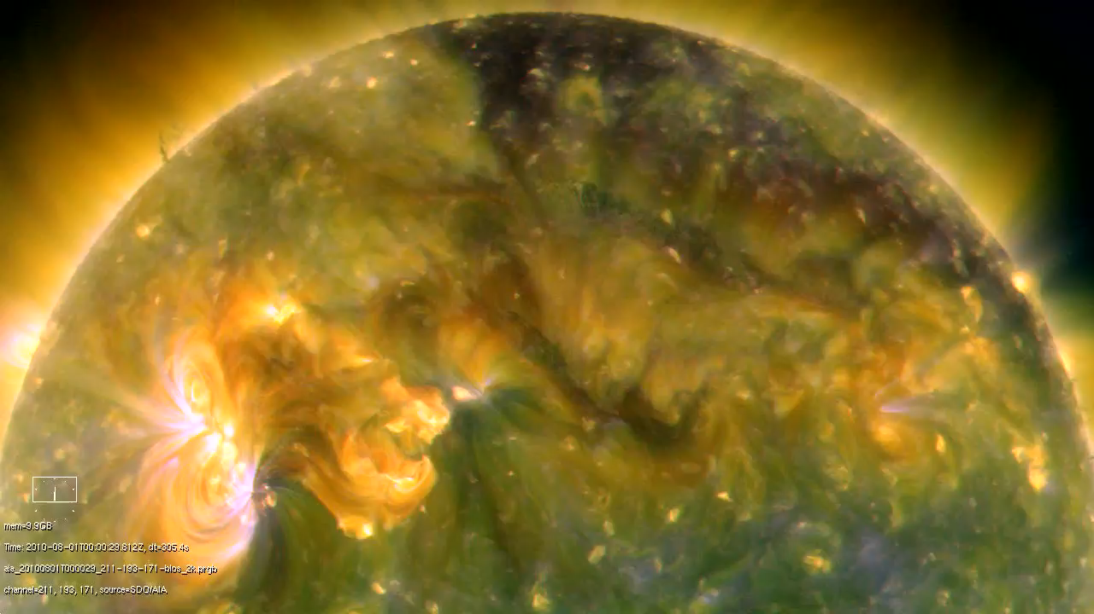
This is a star
This is our star
You are here

Slide 6
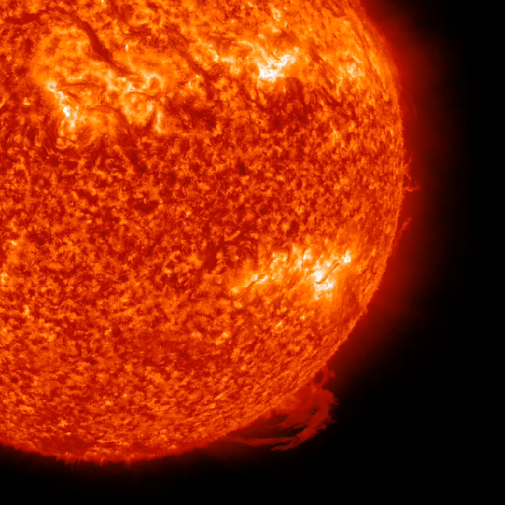
You are (still) here

Slide 7
