Slide 1
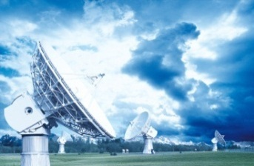
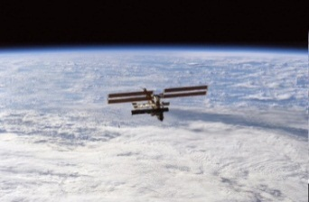
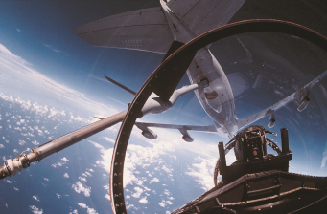
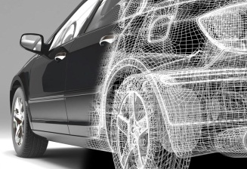
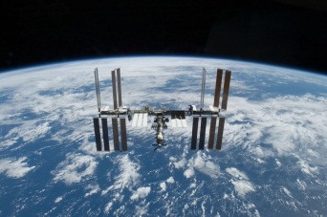
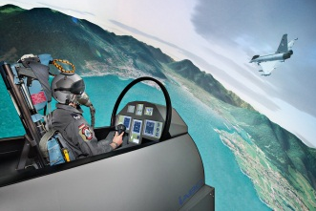
AUTOMOTIVE
INFOCOM
TRANSPORT, ENVIRONMENT & POWER ENGINEERING
AERONAUTICS
SPACE
DEFENCE & SECURITY
Environmental Tests on Solar Orbiter Satellite IABG Space Test Center Uwe Bertram
Ottobrunn 18.10.2019
SPACE

Slide 2
Contents
General Conditions
Environmental Testing
3. IABG Test Facilities
3.1 Infrastructure and General Services
3.2 Sine Vibration Tests
3.3 Acoustic Noise Tests
3.4 Shock Measurements
3.5 Mass Properties Measurements
3.6 Thermal Vacuum and Solar Simulation Tests
3.7 EMC Test
3.8 Magnetic Tests at MFSA

Slide 3
Environmental Tests at IABG
1. General Conditions
Environmental Tests on Solar Orbiter Satellite STM and PFM
Contract signed in December 2014
Test Campaign STM from Mar. 2015 to Dec. 2015
Test Campaign PFM from Sep. 2018 to Oct. 2019
Special Particle and Molecular Cleanliness Requirements on PFM
Special Magnetic and Electromagnetic Cleanliness Requirements on PFM
Departure to Launch Site End of October 2019
Launch February 2020

Slide 4
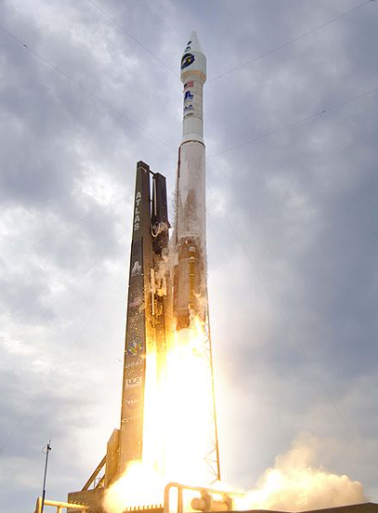
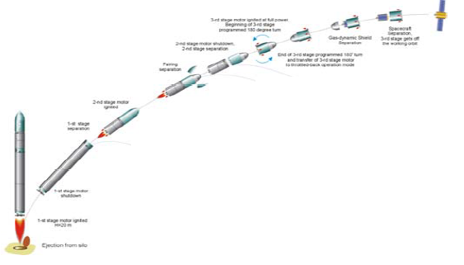
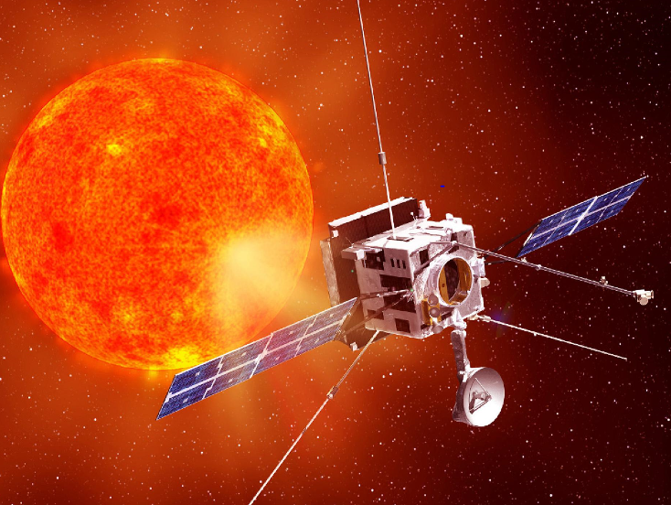
Environmental Tests at IABG
2. Environmental Testing
Flight
S/C Mass, CoG
Vibration
Separation Shock
Deployment Schocks
Space
Rocket Launch
Vacuum
Space Temperature Environment
Solar Illumination
Magnetic
Vibration
Acoustic
Acceleration

Slide 5
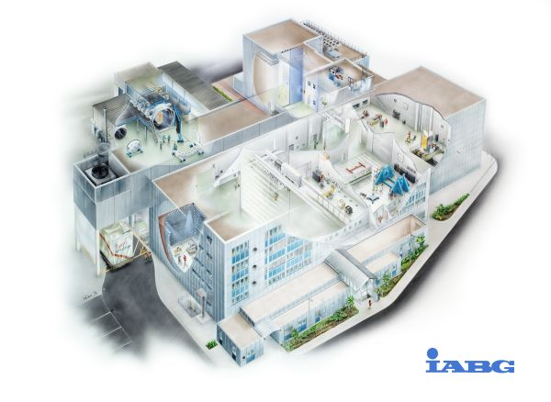
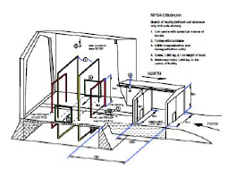
Environmental Tests at IABG
3. IABG Test Facilities
Acoustic Noise
Space
Simulation
Sine Vibration
Preparation
MPM
Deployment
EMC
Magnetic

Slide 6
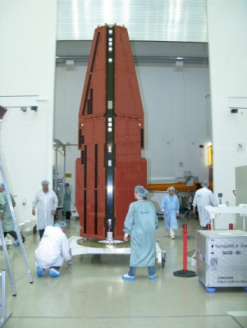
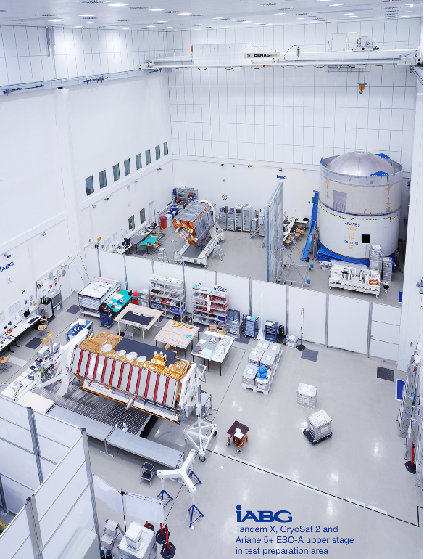
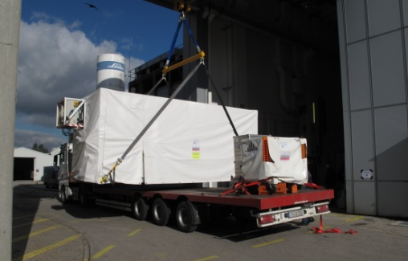
Environmental Tests at IABG
3.1 Infrastructure and General Services
Clean Room Class 8
Crane
UPS
Customer Offices
S/C Integration / Handling
Functional Testing
Tank Fueling
S/C Operation
EGSE Checks
…

Slide 7
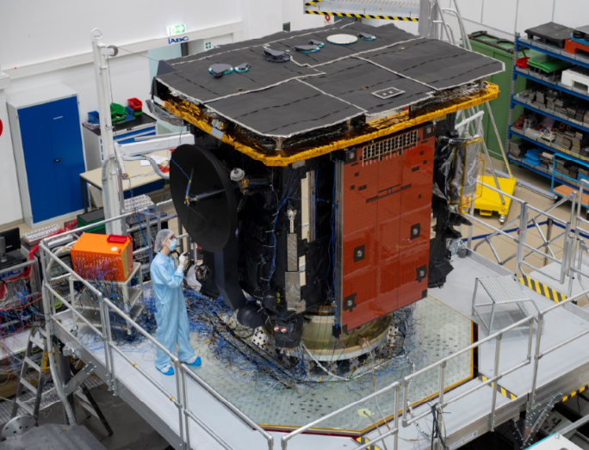
Environmental Tests at IABG
3.2 Sine Vibration Tests
Sinusoidal Excitation along three S/C axes
IABG‘s 320kN Multi Shaker System
500+ Measurement Signals

Slide 8
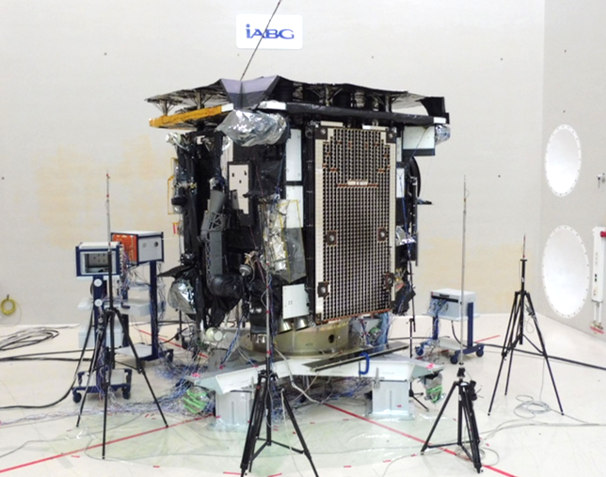
Environmental Tests at IABG
3.3 Acoustic Noise Tests
Pre-defined Noise Levels
500+ Measurement Signals

Slide 9
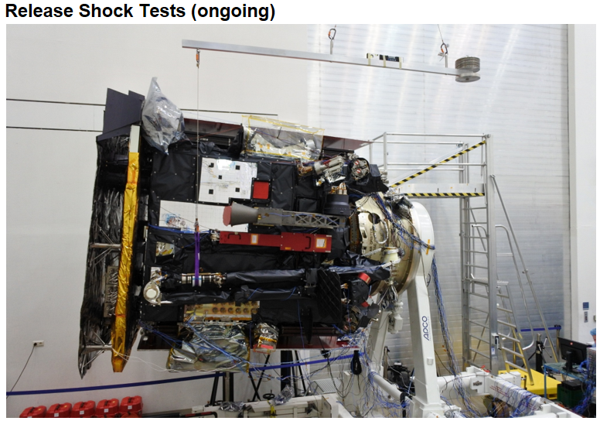
Environmental Tests at IABG
3.4 Shock Measurements
Deployment Shock Tests on I-Boom, Solar Arrays, MGA and HGA Antenna

Slide 10
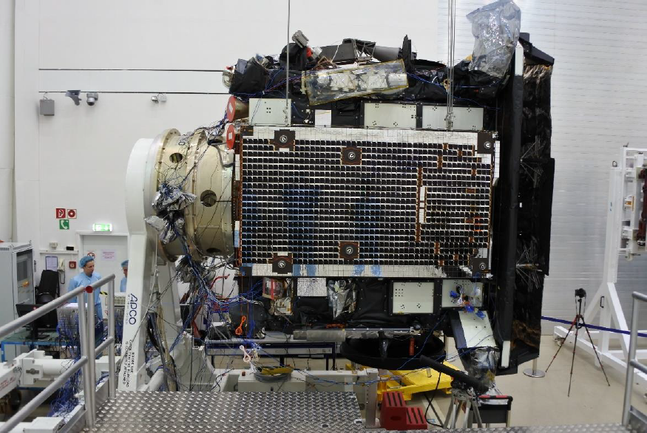
Environmental Tests at IABG
S/C Solar Array Deployment and Shock Measurement

Slide 11
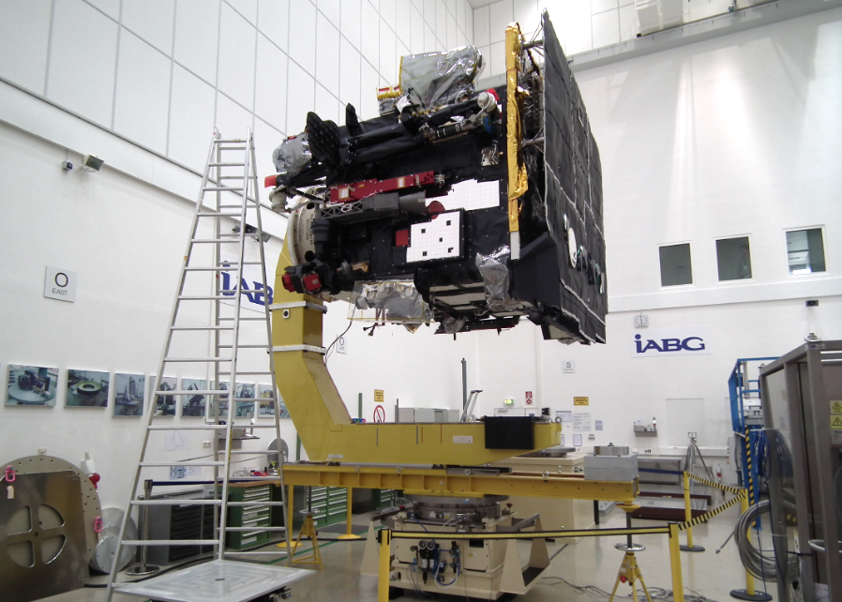
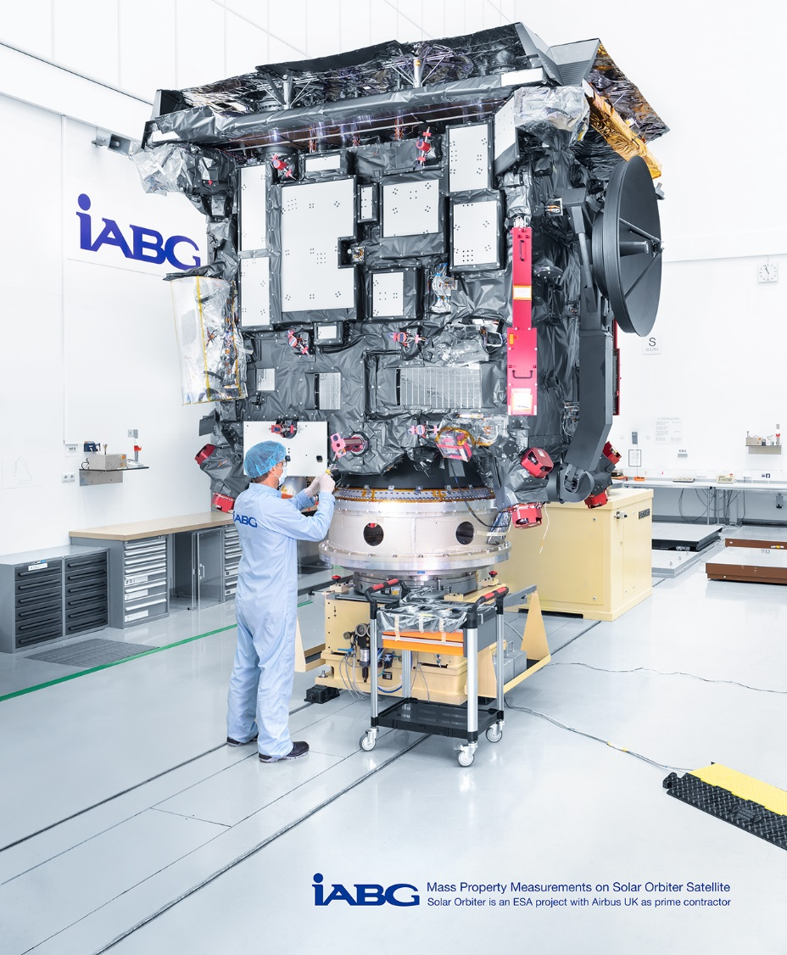
Environmental Tests at IABG
3.5 Mass Properties Measurements
S/C Mass
Center of Gravity
Moments of Inertia

Slide 12
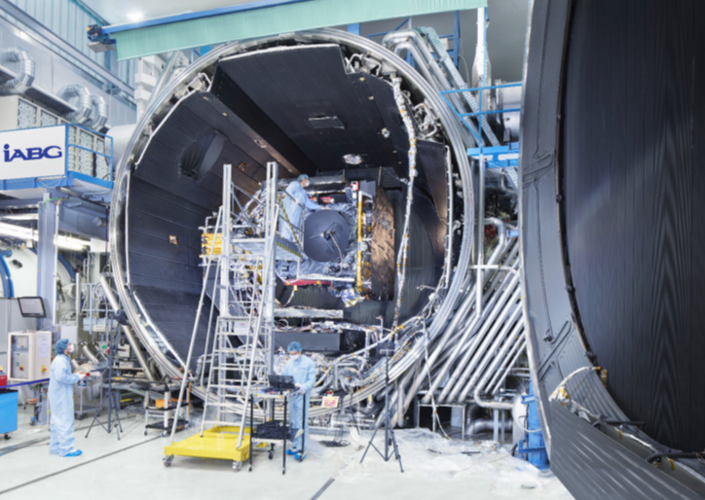
Environmental Tests at IABG
3.6 Thermal Vacuum and Solar Simulation Tests
Test facility conditions:
Vacuum < 1e-5 mbar
Temperature < -178°C (LN2)
Solar illumination (orbital spectrum) at 1850 W/m²

Slide 13
Environmental Tests at IABG
Thermal Imaging Camera: S/C in TVA Chamber (Time Lapse)

Slide 14
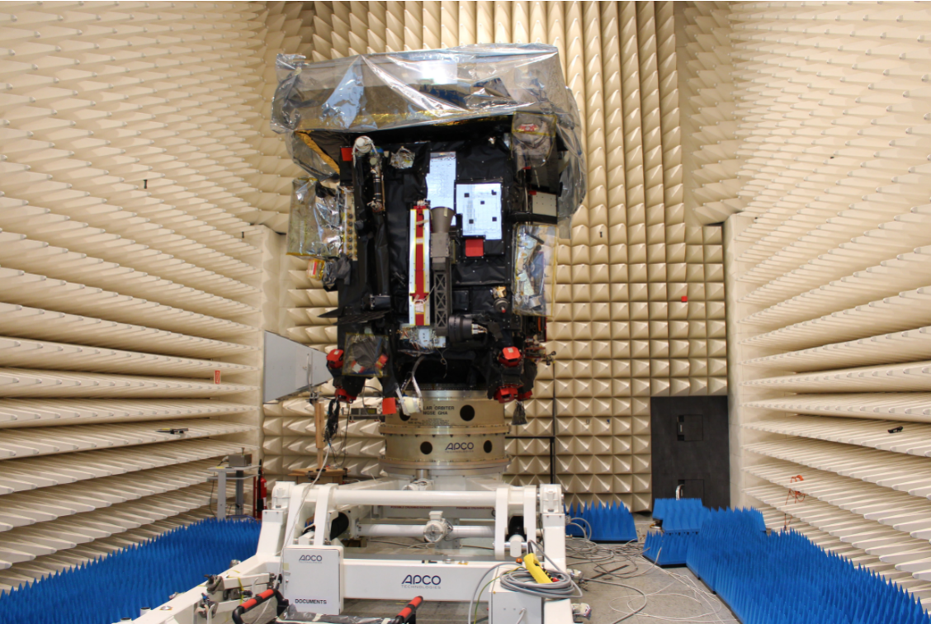
Environmental Tests at IABG
3.7 EMC Test
Electromagnetic Compatibility:
Radiated Emission
Radiated Susceptibility
…

Slide 15
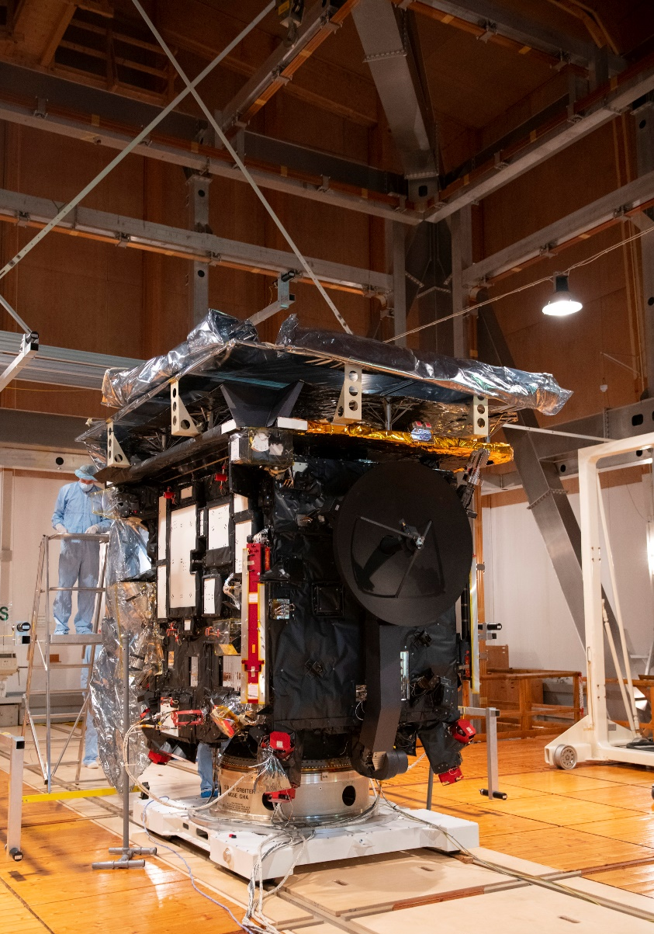
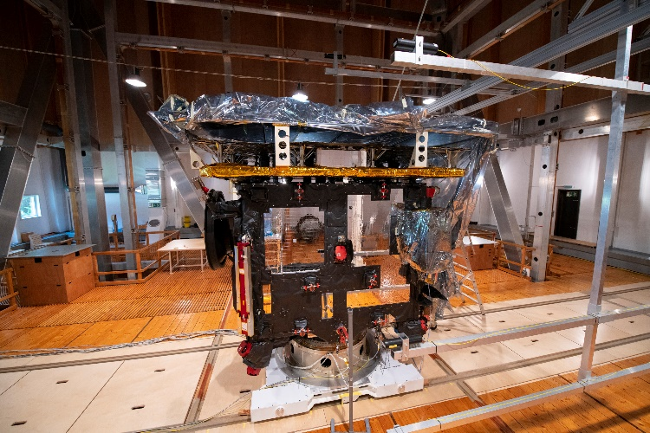
Environmental Tests at IABG
3.8 Magnetic Tests at MFSA
Determination of magnetic signals caused by the S/C
Compensation of Earths Magnetic Field: ‘Magnetically Clean’ environment

Slide 16
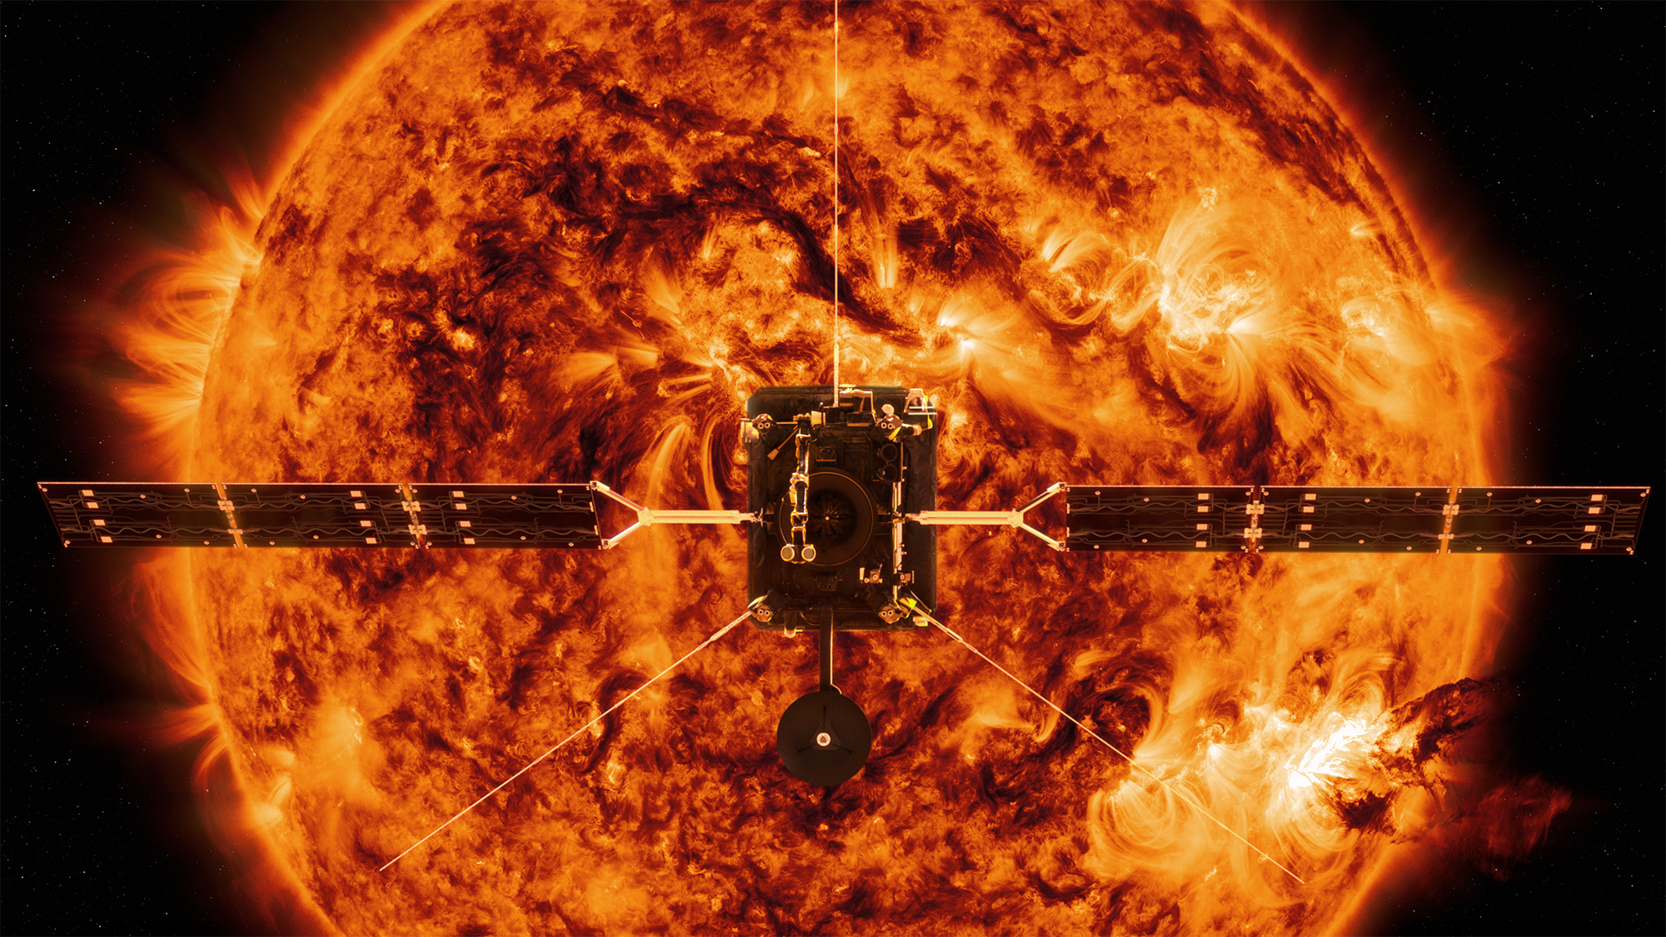
Thank you for your attention!
Picture from ESA webpage

Slide 17
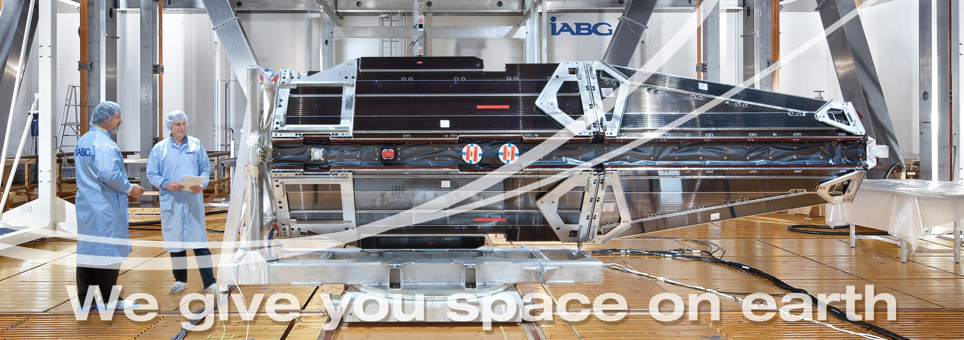
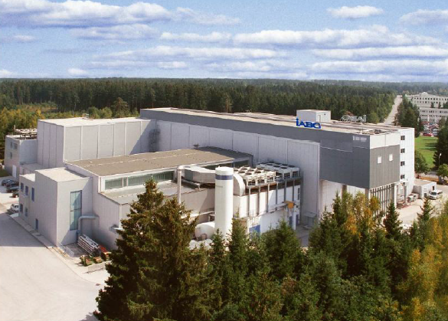
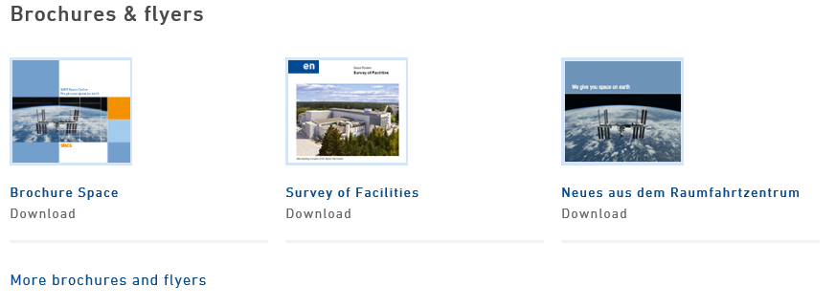
IABG mbH
Project Manager Solar Orbiter Test Campaign
Uwe Bertram
Einsteinstrasse 20 • 85521 Ottobrunn • Germany
Phone: +49 89 6088-2536
Fax : +49 89 6088-3194
Email: bertramu@iabg.de
www.iabg.de/space

